Slide 1
What is it?
Notes:
Hi, my name is Nick Burant, I’m here from the Coalition for Clean Air, and we’re going to talk about the air quality index, or the AQI, for short.

Slide 2
Presentation Outline
What is the AQI?
How does AQI work?
Where can I find the AQI?
How can I use the AQI?
Notes:
First we’re going to discuss what the AQI is, then how it works. From there we’ll move on to where to find it and we’ll wrap up with a discussion on how to use it.

Slide 3
What is the Air Quality Index?
Notes:
We’ll start with a question: What is the air quality index? What do you think it is? There are no right or wrong answers.
Write the answers on the big post-its and engage with the audience.

Slide 4
Provides Information About Health Impacts & Effects
Notes:
This is what the air quality index looks like. It provides information about health impacts and effects.

Slide 5
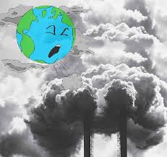
What is the Air Quality Index
The Air Quality Index (AQI) is an tool that is used to report daily levels of the (5) pollutants regulated under the Clean Air Act.
ground ozone
particulate matter
carbon monoxide
sulfur dioxide
nitrogen dioxide
Notes:
The Air quality index is a tool that is used to report the daily levels of the five pollutants regulated under the Clean Air Act. These are the pollutants that we covered in the last presentation, ground ozone, particulate matter, carbon monoxide, sulfur dioxide and nitrogen dioxide.
I should note that lead is not included in the air quality index.
The information is provided using colors, numbers and words. We’ll get more into this in a bit.
Let’s examine the Clean Air Act, which regulates these pollutants.

Slide 6
Notes:
The Clean Air Act is a law passed by Congress in the 1970’s designed to protect public health from different types of air pollution. It says that everyone has a right to clean air.
The Clean Air Act tracks the major sources of pollution, most notably, the types of emissions described in the previous presentation.
It has been revised several times notably in the 1980s & the 1990s.
The Clean Air Act has been hugely successful, it has prevented around 160,000 deaths and saved over $2 trillion dollars because of air quality improvements.
To the group: Why do you think air quality is important?
Acknowledge what they say and move on to the next slide.

Slide 7
What Impacts Air Quality?
LA on a clear day
LA on a smoggy day
Notes:
Most people think that good air quality means clear skies that look like the photo to the left and the absence of ugly days like the photo to the right.
However, it’s not just about smog or how the air looks, and the air quality index is our window into how good the air actually is, making it an essential public health tool.

Slide 8
How does it work?
Notes:
We just reviewed a brief history of the AQI and why it was created.
Next we’ll cover how it works.

Slide 9
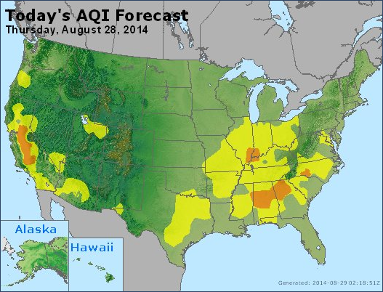
How the AQI works
Monitors are set up across the country to track the 5 major pollutants
Data is analyzed and ranked by colors to show pollution levels
Notes:
Air quality monitors are set up across the country that track the five major pollutants.
Data is analyzed and ranked with colors to show pollution levels.
Cities with large populations like LA have to report the AQI scores for the five pollutants on a daily basis. These scores help researchers forecast future air quality indexes.

Slide 10
How are the levels calculated?
Every day, monitors record the concentration of the (5) major pollutants.
The measurements are converted to an AQI score for each of the pollutants.
Notes:
Let’s take a look at how the AQI is made.
Every day, monitors record the concentration of these pollutants. The measurements are converted into an AQI score for each pollutant.

Slide 11
The highest AQI score is reported as the level for that day.
The score of the pollutant that is the highest is reported as the AQI
BUT other pollutants of concern are placed on the warning list
Notes:
The highest AQI score of the five pollutants is reported as the level for that day. However, other pollutants of concern are placed on the warning list.
The warning list is important because other dangerous pollutants may also be in high concentrations that aren’t represented in the single AQI score. To limit exposure and impact, the entire score must be considered.

Slide 12
How does the AQI Work?
The Color GREEN is equal to 0-50 on the index and it indicates GOOD air quality.
It poses little or no risk
YELLOW is 51-100 and indicates MODERATE air quality.
There may be a moderate health concern for a very small number of people who are unusually sensitive to some pollutants.
The Air Quality Index Provides Information about Health Impacts and Health Risks using colors, numbers and words.
Notes:
The Air quality index provides information about health impacts and health risks using colors, numbers and words.
These rakings are based on a public health standard. These standards establish what is safe for public health.

Slide 13
How does the AQI Work?
ORGANGE: 101 to 150 is Unhealthy for Sensitive Groups.
Ozone: People with lung disease, children, older adults, and people who are active outdoors.
Particle pollution: People with heart or lung disease, older adults, and children.
Notes:
People who are active outdoors: One of my hobbies is running, and on orange days I have to make sure I don’t run too much. The limit is usually an hour of strenuous activity, so I pay attention to the AQI when I’m planning a run that long.

Slide 14
RED:151-200 is UNHEALTHY.
How does the AQI Work?
Everyone may begin to experience health effects. Members of sensitive groups may experience more serious health effects.

Slide 15
How does the AQI Work?
PURPLE: 201 to 300is VERY UNHEALTHY.
This would trigger a health alert signifying that everyone may experience more serious health effects.

Slide 16
How does the AQI Work?
MAROON: an AQI that is more than 300 is HAZARDOUS.
This would trigger a health warning of emergency conditions. The entire population is more likely to be affected.
Maroon warnings are rare.

Slide 17
Air Quality Index
How can I use the index?

Slide 18
How do I protect my health?
Lets you know if you or your family is at risk
You can then plan the activities for your day
If necessary, you can also limit the amount of time you spend outdoors
Notes:
To the audience: How How do you think you can use this information to protect your health?
Audience will write on the big post its.
The AQI lets you know if you or your family is at risk.
You can plan your activities for the day.
If necessary, you can limit your time spent outdoors. For example, if you had planned a day at the beach, you might change your plans if there’s an orange day. Maybe a day at the museum is a better idea.

Slide 19
Sensitive Populations
Children
Pregnant Women
Older Adults
Notes:
To the audience: Why do you think these are sensitive populations?
Kids – Lungs are still developing, bad air can hamper their development
Elderly – The term I saw was physiologically weak, their body systems aren’t as strong as they used to be.
Pregnant women – Bad for the development of the baby. Studies have found low birth weight and other health effects to be correlated with poor air quality.

Slide 20
Sensitive Populations
Lung & Heart Disease
People Active Outdoors
Notes:
To the audience: Why do you think these are sensitive populations?
Lung & Heart disease: Their organs are weaker and air pollution does damage to the already weakened system
People active outdoors: Basically, they breathe hard and maximize their exposure.
Before we go on (ask the audience): How do you think you can use this information to protect their public health? Have we learned anything new?

Slide 21
Air Quality Index
Where can I find the index?
Notes:
By this point we can all safely say that the air quality index is an important tool in protecting or limiting our exposure to air pollution.
To the audience: Where do you think you can find this helpful tool?

Slide 22
Where can I find the AQI?
You can find the AQI in the following places.
Online
Via email
Local news paper
Local news
On your smart phone
Notes:
Highlight the ones they said and mention the ones they didn’t.
Before next slide:
To audience: How would you share the AQI with others? How would it be utilized in your community? We’re going to circle back to this.
Write down answers on white board

Slide 23
Online: www.airnow.gov
Notes:
www.airnow.gov Wilmington: 90744
Group Exercise: Web search; compare & contrast the following neighborhoods
Wilmington
Santa Monica
Boyle Heights
Etc……

Slide 24
Local News Paper
Notes:
[Pass out the newspaper] The LA Times has AQI forecasts on its weather page.
Ask participants if they see a pattern of bad AQI scores in certain areas
Discuss why this could be.
Point to the sources from the previous presentation (Wilmington: refineries and ports)
Also point to the importance of wind patterns. Riverside and quite a bit of the inland empire get a lot of the pollution generated by LA traffic, the ports and refineries.

Slide 25
Local News
Notes:
[If possible: watch this video: http://losangeles.cbslocal.com/2014/05/16/smoke-advisory-issued-for-oc-portions-of-la-riverside-counties/]
To audience: Have you have seen the AQI reported on other stations? Are there times of the year or instances where they are more keenly aware of poor air quality?

Slide 26
Via Email: www.enviroflash.info
Notes:
You can get air quality notifications sent to you daily by signing up at enviroflash.com

Slide 27
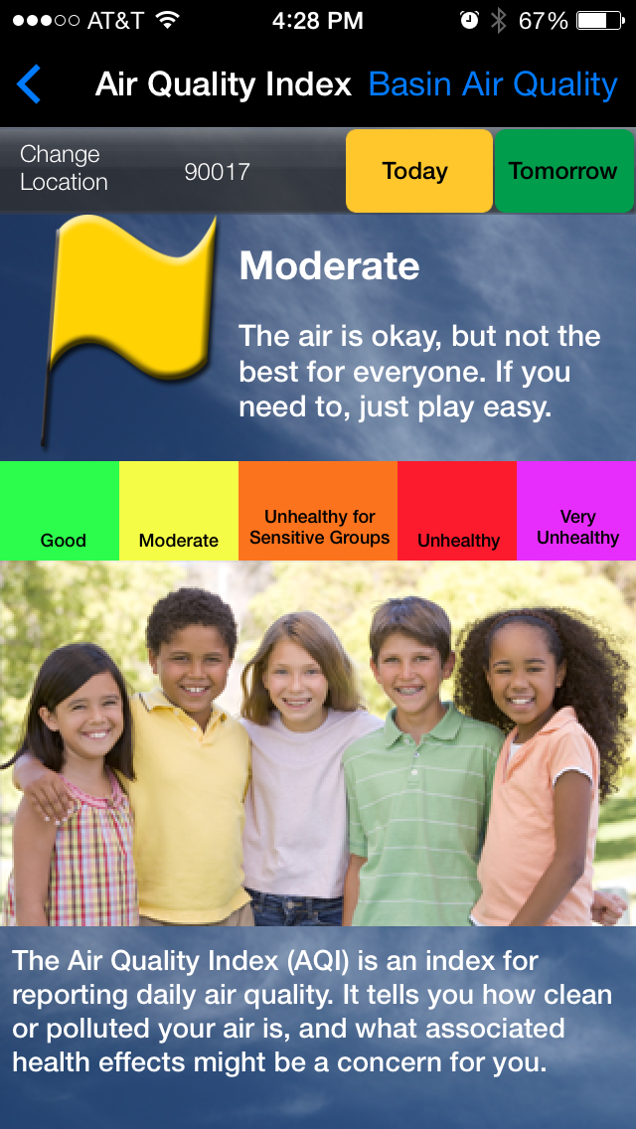
Smart Phone
IPhone
Android
Notes:
You can also get AQI information by downloading the AQMD app. It’s available for iPhone and Android devices.
[Pass the phone with app to group]

Slide 28
how would You share the AQI with others? how could it be utilized in your community? How can clinics use the aqi to improve patient health?
Notes:
To audience: How can we further our previous discussion on sharing the AQI with others, using in the community? How can clinics use the AQI to improve patient health?
Show examples of projects and form a discussion.

Slide 29
Take-Away
What was one thing you took away from this presentation or one thing you learned?

Slide 30
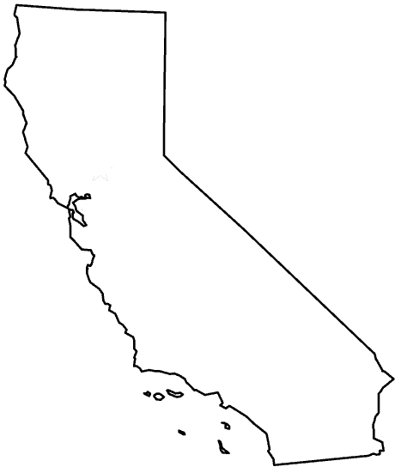
Thank You
If you have additional questions you can contact us at ccair.org
Notes:
30
CCA has two offices in California: Sacramento and Los Angeles.
You can find us online at ccair.org, or feel free contact us directly.

