Slide 3
#clearingtheair
@CleanAirCA

Slide 4
Platinum Sponsor

Slide 5
Platinum Sponsor

Slide 6
Platinum Sponsor

Slide 7
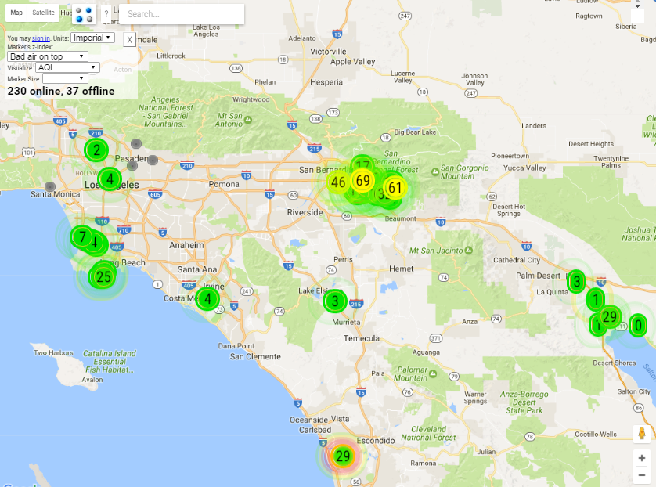
Join our network today at www.ccair.org/clear-network

Slide 8
CCA Accomplishments
SB 350 / AB 1550
Directs climate investments to communities disproportionately impacted by air pollution.

Slide 9
Gold Sponsor

Slide 10
Gold Sponsor

Slide 11
Gold Sponsor

Slide 12
Join us May 18th!

Slide 13
CCA Accomplishments
Smog Check
Which reduces 100 tons of automobile pollution daily!

Slide 14
Silver Sponsor

Slide 15
Silver Sponsor

Slide 16
Silver Sponsor

Slide 17
#clearingtheair
@CleanAirCA

Slide 18
CCA Accomplishments
Executive Order on Freight
Sets California on a course to combat the freight sector’s outsized contribution to air pollution

Slide 19
Bronze Sponsor

Slide 20
Bronze Sponsor

Slide 21
Bronze Sponsor

Slide 22
Bronze Sponsor

Slide 23
Bronze Sponsor

Slide 24
Join us May 18th!

Slide 25
CCA Accomplishments
SB 1275
Establishes the Charge Ahead California initiative, with the goal of putting one million electric vehicles on California roads within a decade

Slide 26
Bronze Sponsor

Slide 27
Bronze Sponsor

Slide 28
Bronze Sponsor

Slide 29
Bronze Sponsor

Slide 30
Bronze Sponsor

Slide 31
CCA Accomplishments
PERC
Won the nation’s first ban on “perc,” a toxic dry cleaning chemical that creates smog and threatens human health

Slide 32
#clearingtheair
@CleanAirCA

Slide 33
CCA Board of Directors
Todd Campbell, Board Chair
Tonia Reyes Uranga, Vice Chair
Erik Neandross, Secretary
George Minter, Treasurer
Ed Begley, Jr.
Tom Epstein
Josh LaFarga
Betty Chim-Lieu
Sherry Jackman
Ron Loveridge
Bruce MacRae
Bruce Melgar Macy Neshati Alex Spataru
Chris Thompson

Slide 34
Our Mission
The Coalition for Clean Air protects public health, improves air quality, and prevents climate change.
Areas of Work
California’s Climate Crisis Combating climate change and its effects on those who already suffer from air pollution
Ports & Freight Transport Cleaning up the ships, trucks and trains that bring goods to California and the nation
Driving Clean Transportation Advancing the cars, trucks, trains, planes and buses Californians use every day
General Air Advocacy Regulating air toxics, energy, and other pollution sources at the local, state and federal levels
ccair.org

Slide 35
Join us May 18th!

