Slide 2
CCA Board of Directors
Todd Campbell, Board Chair
Erik Neandross, Vice Chair
Sherry Jackman, Secretary
Ed Begley, Jr.
Betty Chim-Lieu
Nicole Cleary
Tom Epstein
Josh LaFarga
Ron Loveridge
Bruce MacRae
Bruce Melgar
Beth Reid
Rachelle Reyes Wenger
Alex Spataru
Tom Swenson
Chris Thompson

Slide 3
Platinum Sponsors
Gold Sponsors
Silver Sponsors
Air Products
Bay Area Air Quality Management District
Bloom Energy
Clean Energy Fuels
Resource Recovery Coalition of California
San Diego Gas & Electric
Olivine, Inc.
Volvo Group of North America
Bronze Sponsors
Aclima
Advanced Engine Systems Institute
BYD Motors, Inc.
California Electric Transportation Coalition
California Fuel Cell Partnership
Clarity Movement Co.
Clean Power Alliance
Community Environmental Services
Cummins
EVgo
Gladstein, Neandross & Associates
NextGen California
Oberon Fuels
Republic Services
ROUSH CleanTech
SMUD
Sonoma Technology, Inc.

Slide 4
ccair.org

Slide 5
OCTOBER 7, 2020
CLEANAIRDAY.ORG

Slide 8
ccair.org

Slide 10
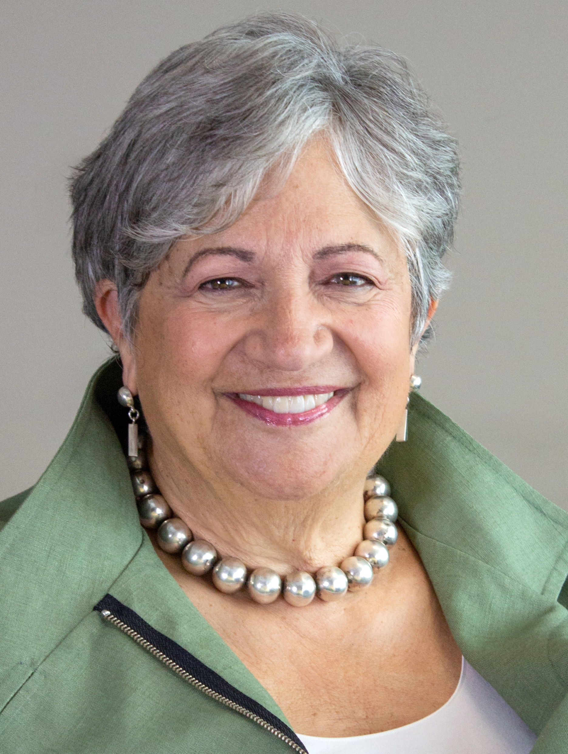
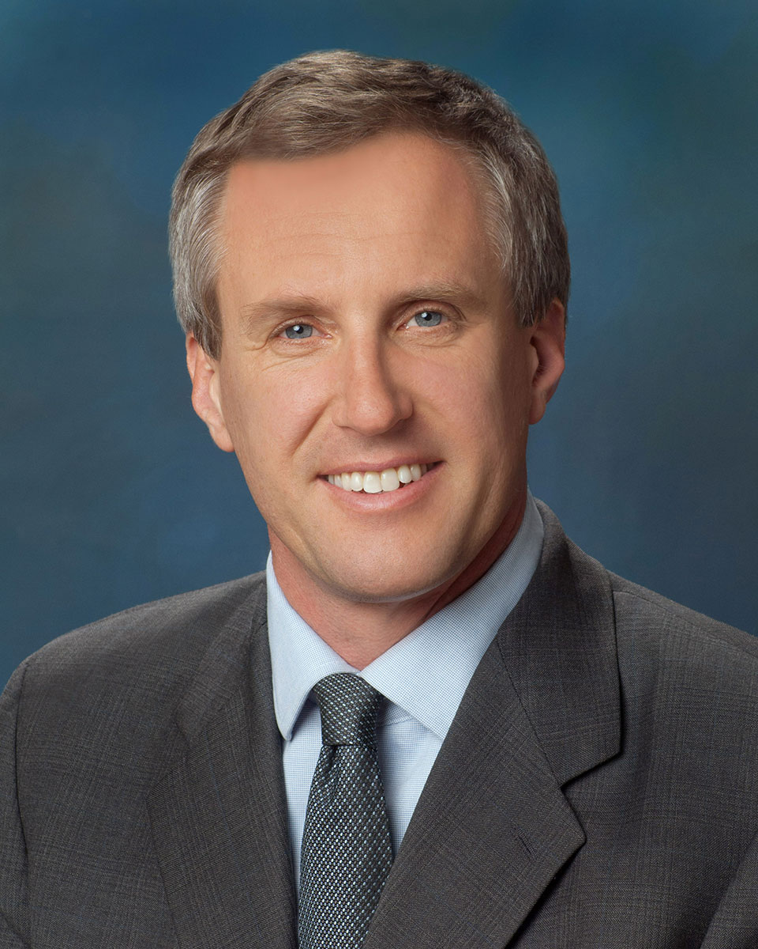
Mary Nichols
Chair,
California Air Resources Board
David Hochschild
Chair,
California Energy Commission

Slide 12
June 5, 2020

